Slide 1
Malaysia Adex
Y2021 vs. Y2020 Report

Slide 2
Y2021 vs. Y2020 Total Adex by medium
+37%
MYR m, Net
+12%
-8%
+0.6%
+4%
-86%
-29%
Source : GroupM, TYNY Nov 2021 Report – updated to FY2021 data for relevant media
*TV, OOH & Internet forecast number

Slide 3
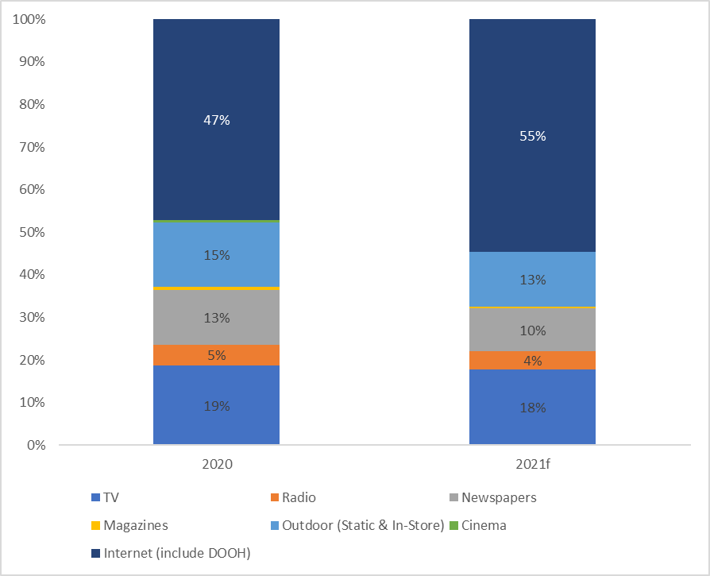
Y2021 vs. Y2020 Adex SOS% by medium
Source : GroupM, TYNY Nov 2021 Report – updated to FY2021 data for relevant media
*TV, OOH & Internet forecast number

Slide 4
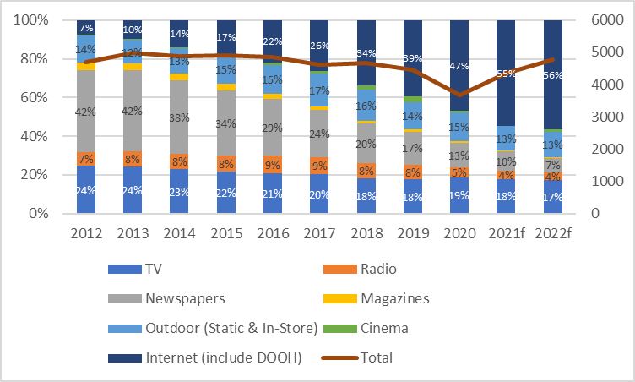
Multi year growth & SOS% trend
4,702 4,973 4,876 4,901 4,865 4,615 4,674 4,462 3,677 4,357 4,780
MYR m, Net
Source : GroupM, TYNY Nov 2021 Report – updated to FY2021 data for relevant media
*TV, OOH & Internet forecast number

Slide 5
Key Summary & Forecast
The Malaysia ad market has started to stabilize from the pandemic and has been on a growing trend since March 2021. Therefore, 2021 advertising market is highly anticipated to restore back to the pre-pandemic level.
Overall, recovery is seen across all media except print & cinema. Digital is expected to close the year at a whooping growth rate of 37% with 55% lion share of spent.
Whilst its no doubt that Digital will be the frontier in driving industry growth, areas of focus will be getting advertisers ready for the cookieless and the rise of more rigorous privacy standards. Advertiser’s roadmap in direct local publishers should start by 2022 to gain learning entering 2023.
Offline and online integration has become vital moving forward as audience shift their consumption behavior seamlessly.

